Slide 1
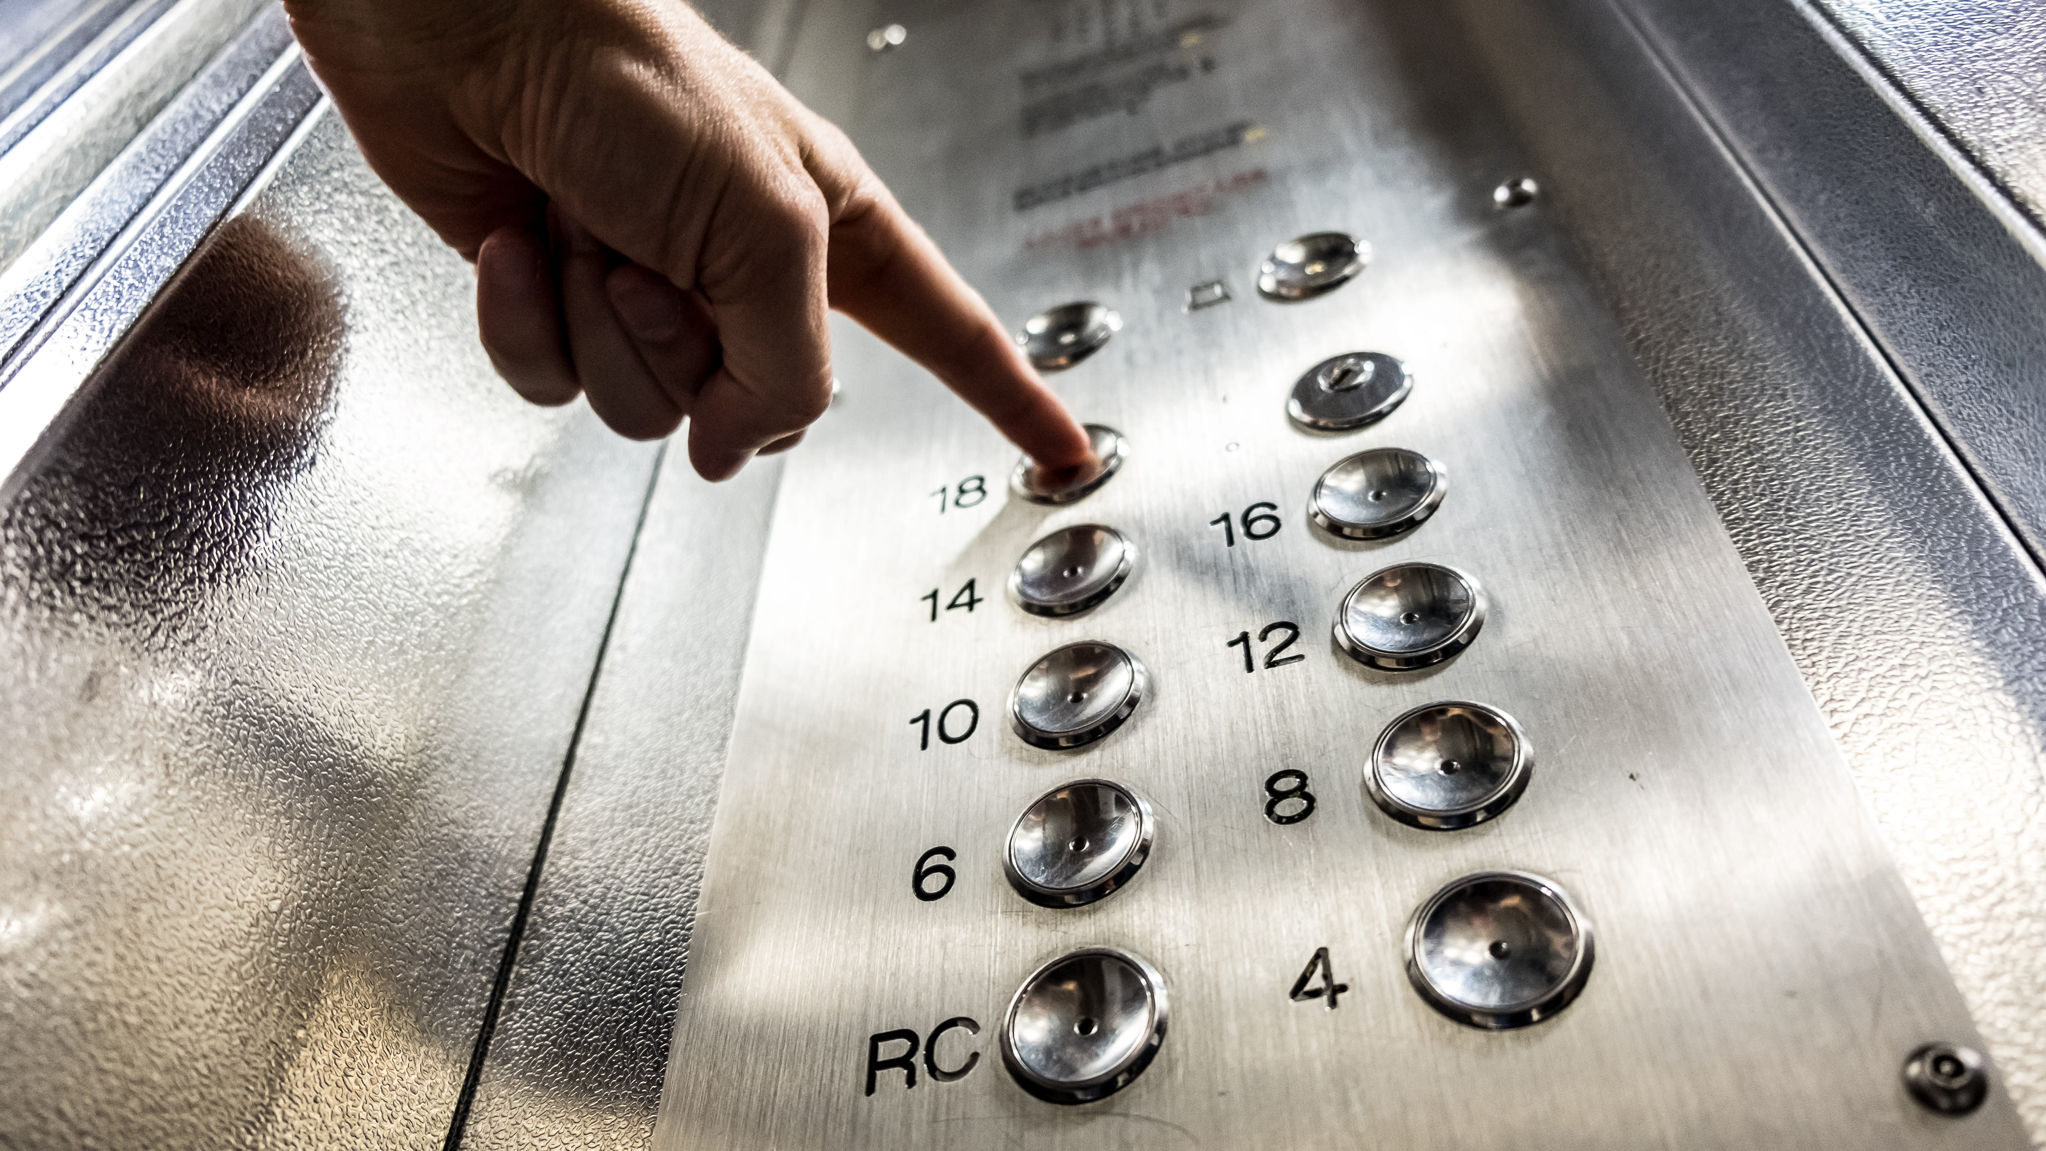
Exercise 4 - NuSMV: Elevator Problem
Saccotelli Leonardo - 761047

Slide 2
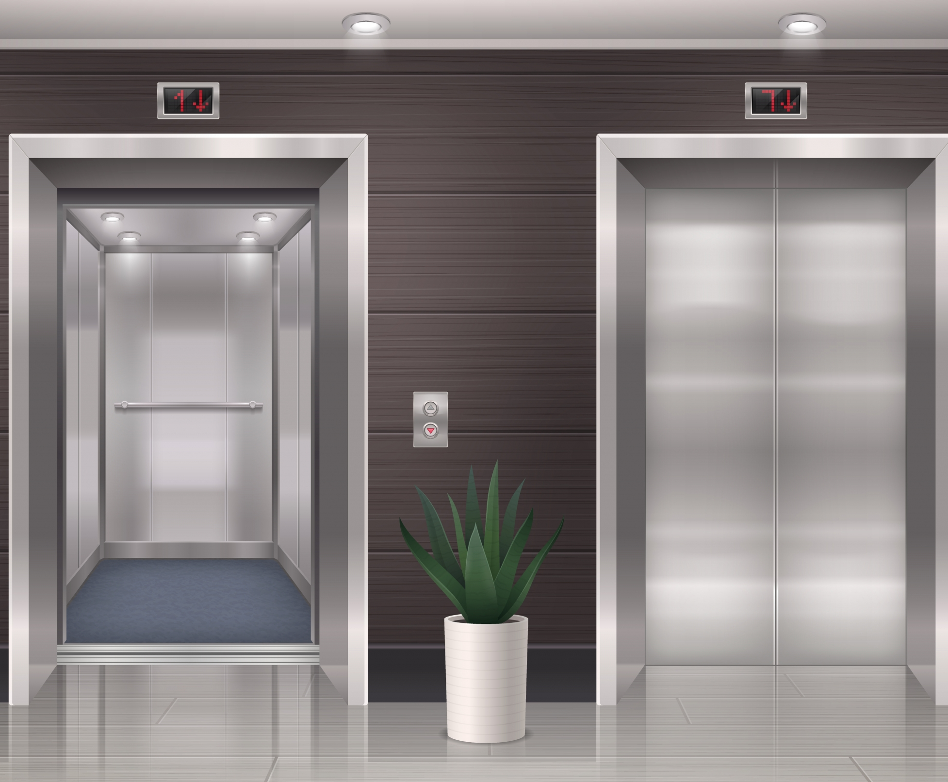
Goal
Formalize the behaviour of an elevator system for a 4-floors building.
Formalize the properties of the elevator using LTL formulas and check that the given requirements are satisfied using NuSMV as model checker.

Slide 3

Model Logic
The system is composed of:
Button
Cabin
Door
Controller

Slide 4
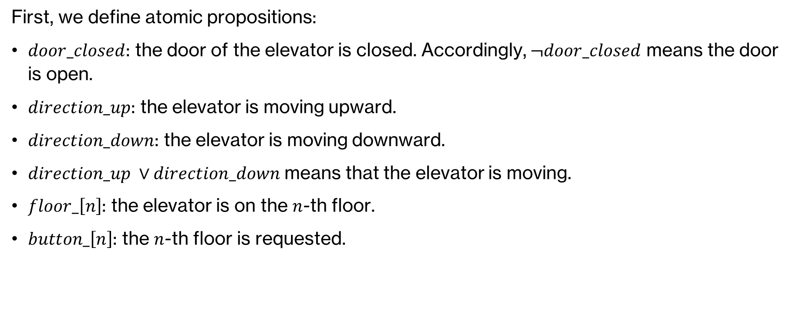
System properties specification
First, we define atomic propositions:
$door_closed$: the door of the elevator is closed. Accordingly, $¬door_closed$ means the door is open.
$direction_up$: the elevator is moving upward.
$direction_down$: the elevator is moving downward.
$direction_up ∨direction_down$means that the elevator is moving.
$floor_\left[n\right]$: the elevator is on the $n$-th floor.
$button_\left[n\right]$: the $n$-th floor is requested.

Slide 5
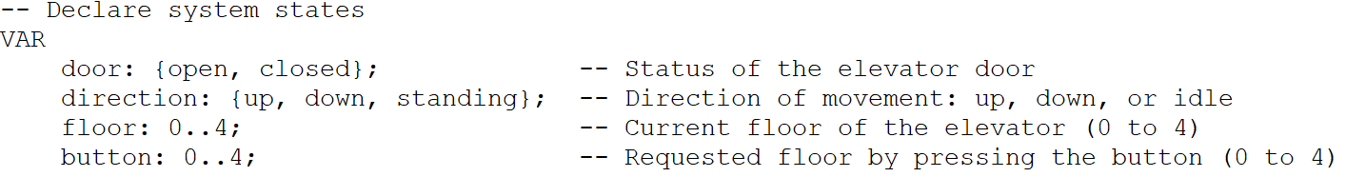
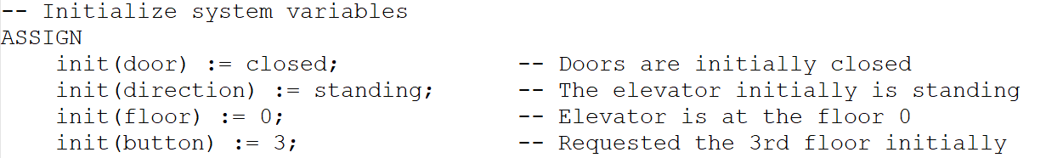
NuSMV Implementation
First, we define the basic component on our system, and we set the initial state for each of the declared variables. Initially, we are at the floor 0, the elevator is not moving (standing), the door is closed, and the request button is the third floor.

Slide 6
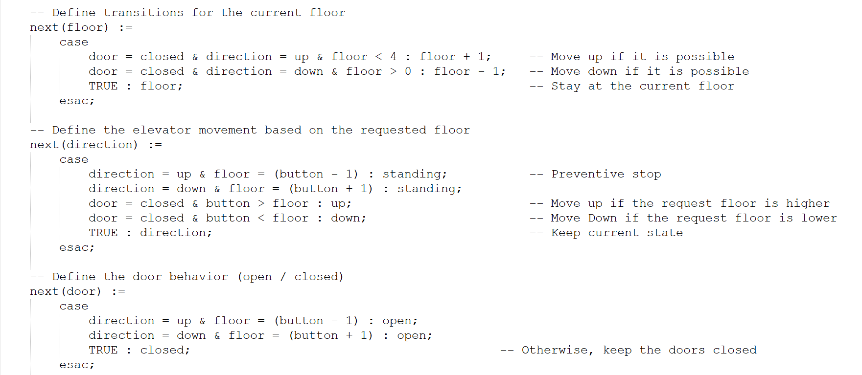
NuSMV Implementation

Slide 7
NuSMV Implementation

Slide 8
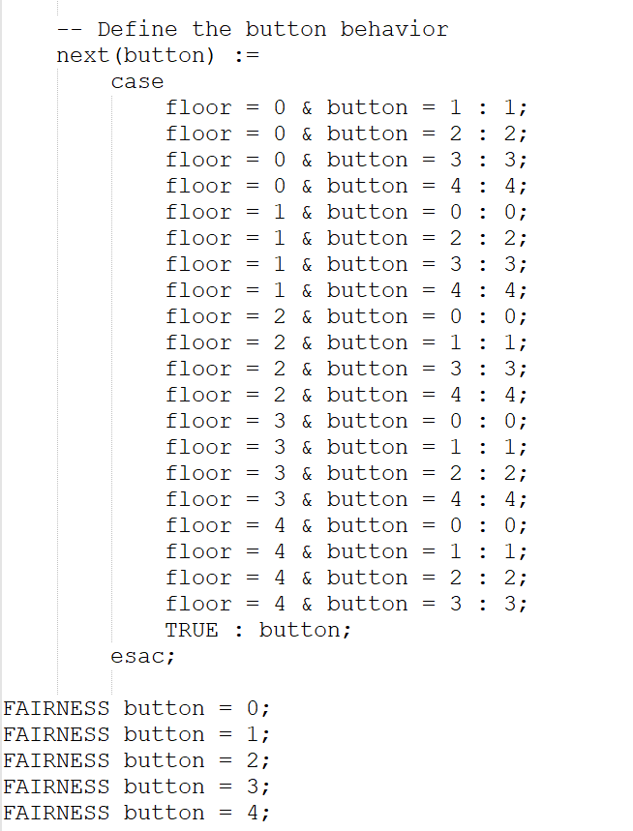
NuSMV Implementation
Fairness constraints ensure that all the floors will be eventually visited.

Slide 9
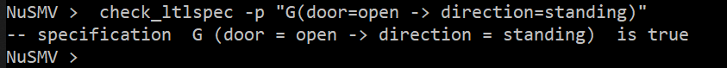
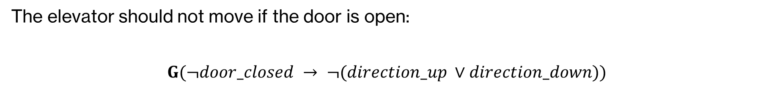
Specification 1
The elevator should not move if the door is open:
$$G(¬door_closed → ¬(direction_up ∨direction_down))$$

Slide 10
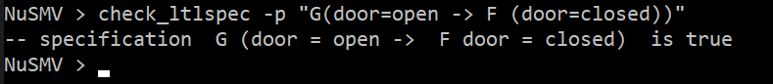

Specification 2
Whenever the door is open, it will eventually be closed:
$$G(¬door_closed →F door_closed)$$

Slide 11
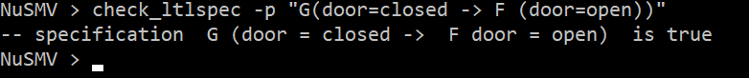

Specification 3
Whenever the door is closed, it will eventually be open:
$$G(door_closed →F¬door_closed)$$

Slide 12
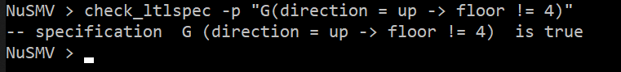
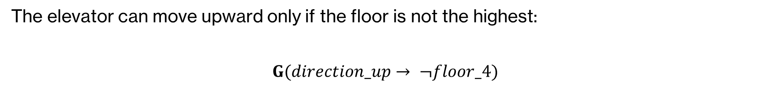
Specification 4
The elevator can move upward only if the floor is not the highest:
$$G(direction_up→ ¬floor_4)$$

Slide 13
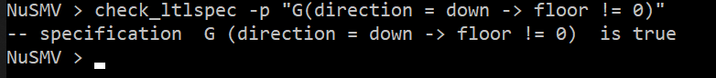
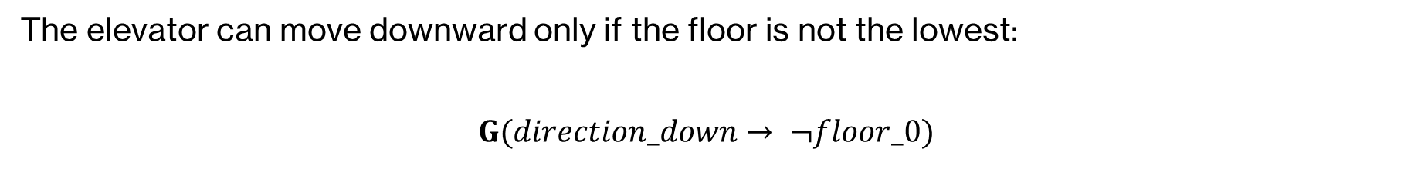
Specification 5
The elevator can move downward only if the floor is not the lowest:
$$G(direction_down→ ¬floor_0)$$

Slide 14
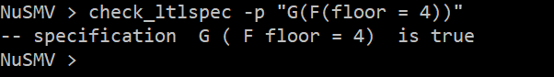
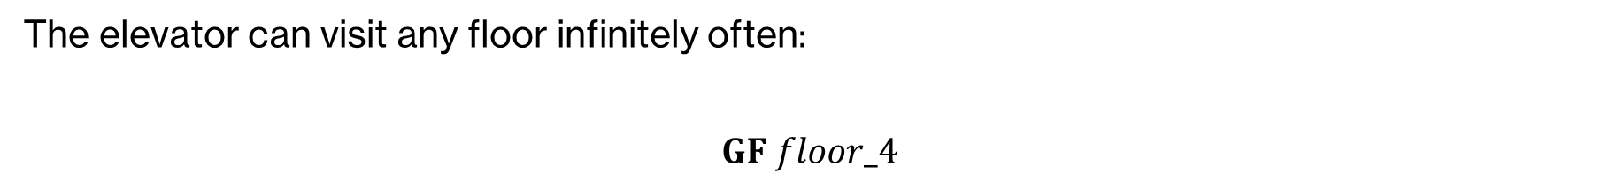
Specification 6
The elevator can visit any floor infinitely often:
$$GF floor_4$$

Slide 15
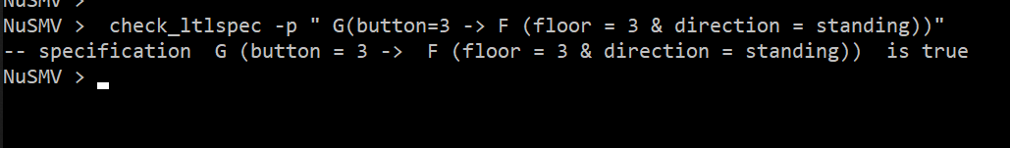
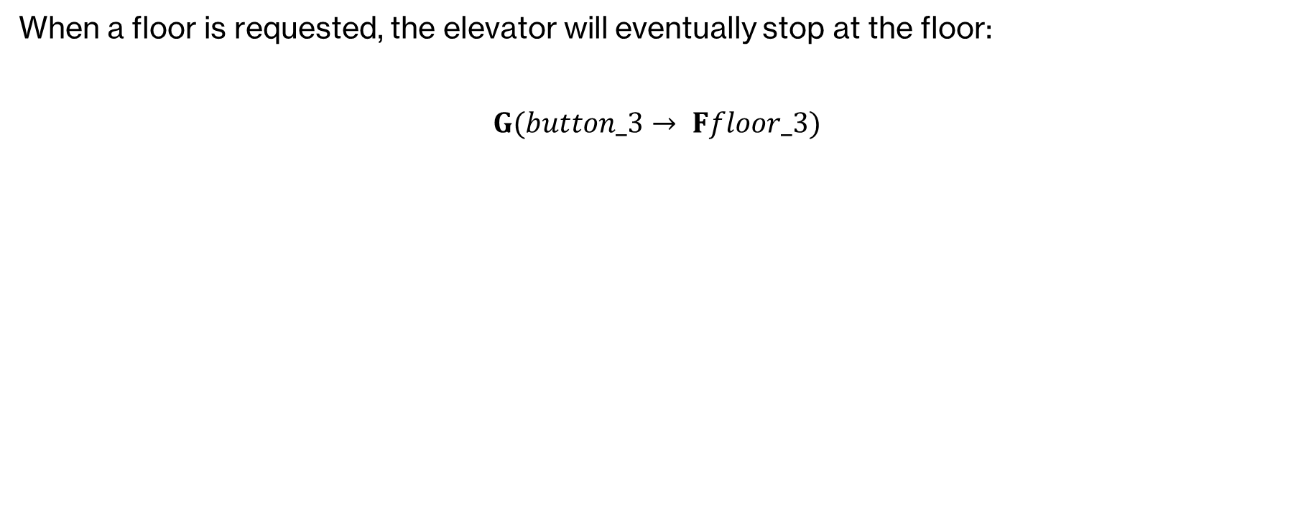
Specification 7
When a floor is requested, the elevator will eventually stop at the floor:
$$G(button_3→ Ffloor_3)$$

Slide 16
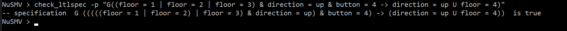
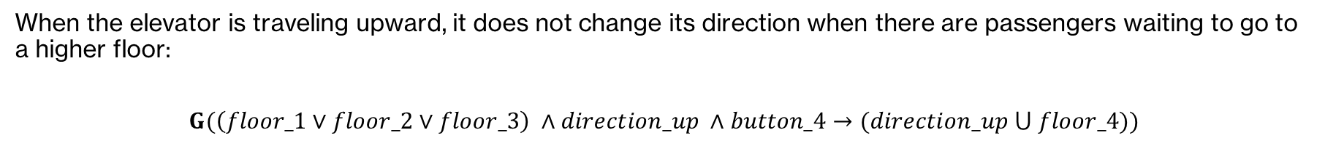
Specification 8
When the elevator is traveling upward, it does not change its direction when there are passengers waiting to go to a higher floor:
$$G(\left(floor_1∨floor_2∨floor_3\right) ∧direction_up ∧button_4→(direction_up ⋃ floor_4))$$

Slide 17
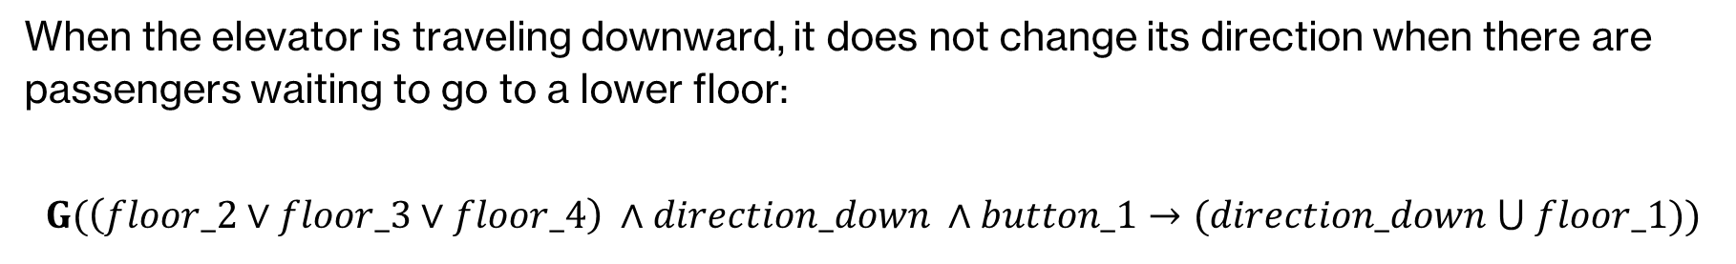
Specification 9
When the elevator is traveling downward, it does not change its direction when there are passengers waiting to go to a lower floor:
$$G(\left(floor_2∨floor_3∨floor_4\right) ∧direction_down ∧button_1→(direction_down ⋃ floor_1))$$

Slide 18
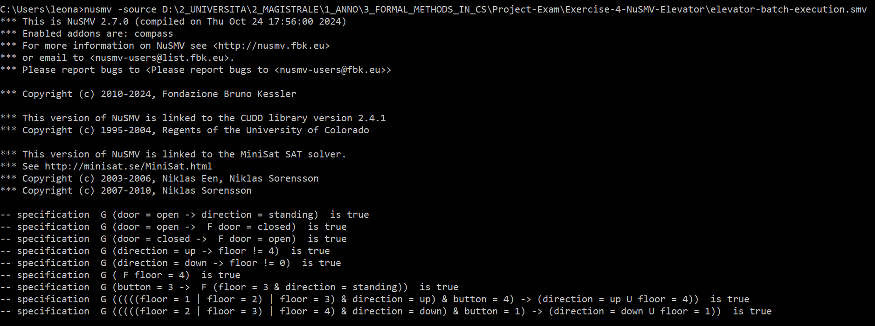
Batch Execution of the model

Slide 19
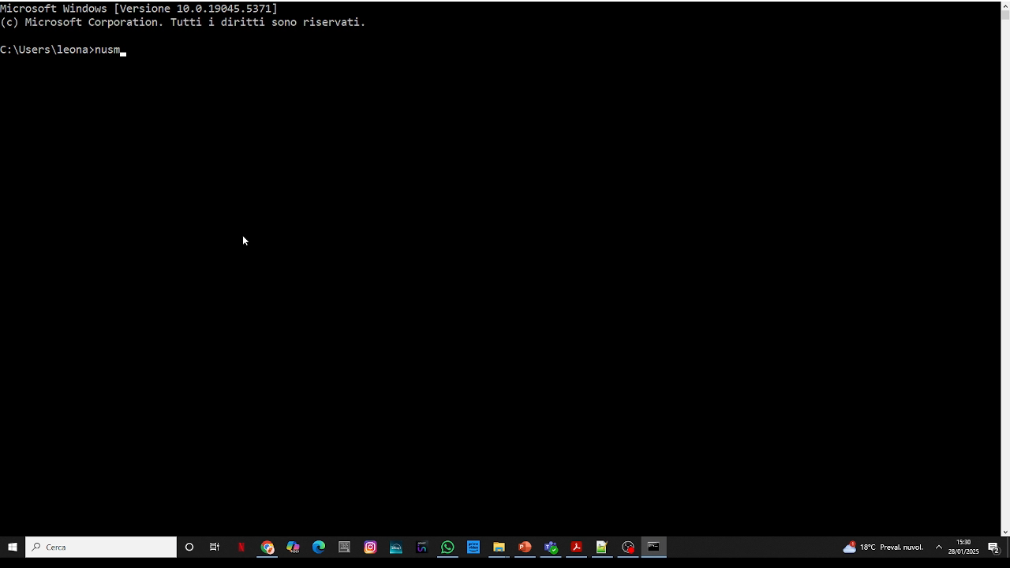
Batch Execution of the model

Slide 20
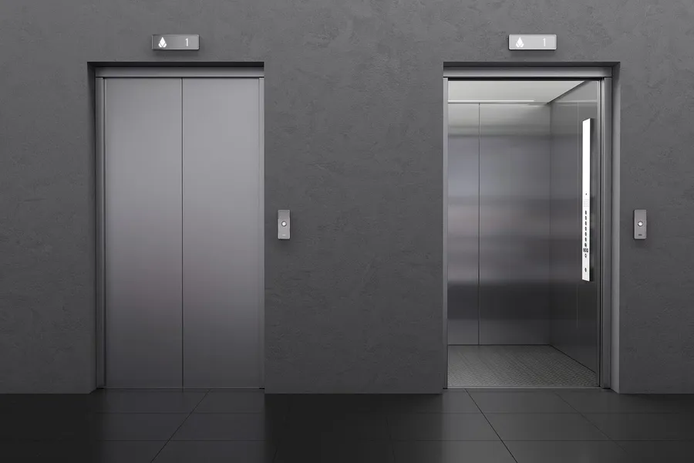
Thank for the attention Formal methods for computer science Prof. Berardina De Carolis Università degli studi di Bari Aldo Moro Computer Science
Leonardo Saccotelli
l.saccotelli@studenti.uniba.it

